Slide 1
Medium Access:

Slide 2
What is Routing Protocols?
Routing Protocols are the set of defined rules used by the routers to communicate between source & destination.
Routing is the process of moving information from a source to a destination across the internetwork.
Routing takes place at Layer 3 (the network layer) of the OSI model.
Networks employ a combination of static and dynamic routing.
Static routing is preferable for small networks, whereas dynamic routing is ideal for large networks.
A combination of static and dynamic routing is usually used in real networks.

Slide 3
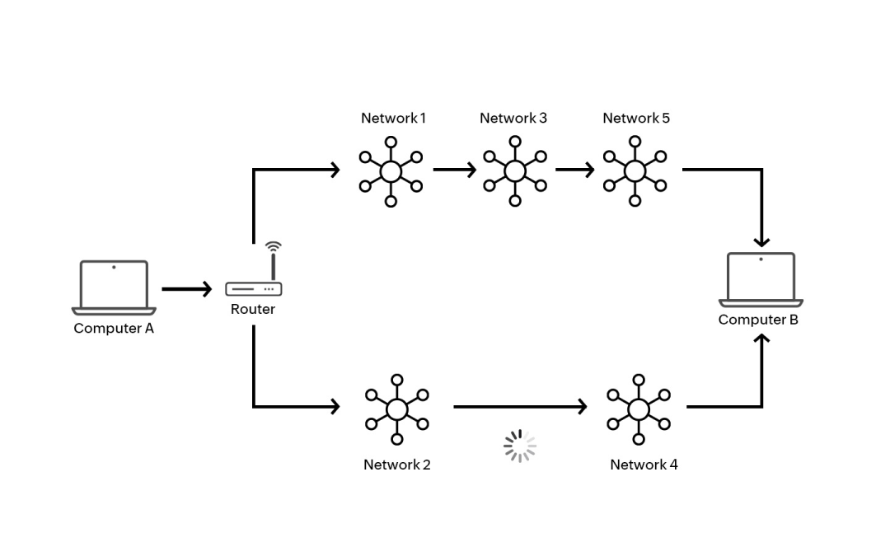

Slide 4
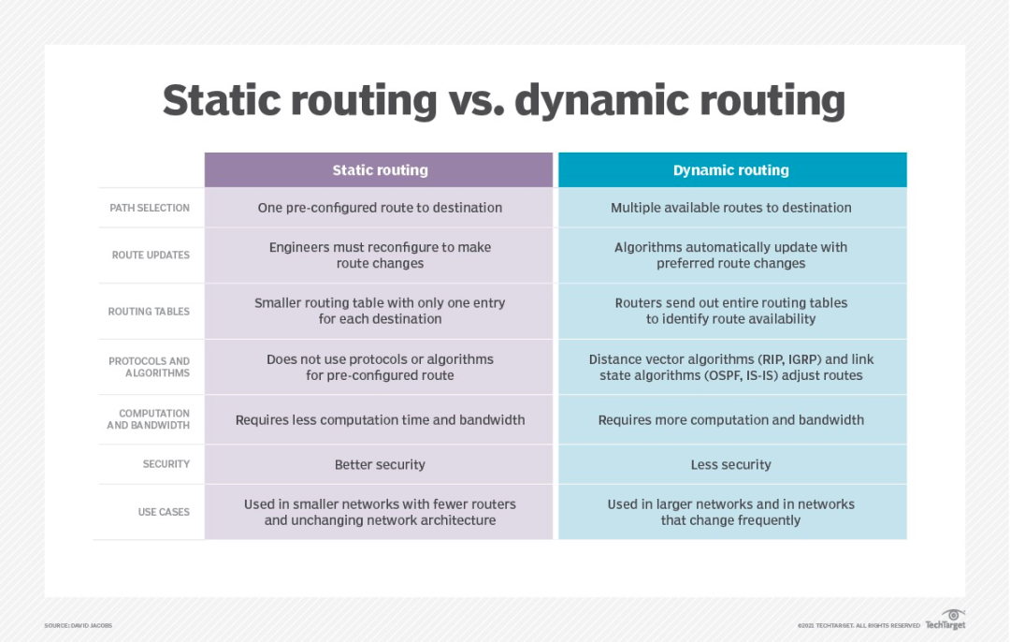

Slide 5
Static Routing Protocols
Static routing protocols are used when an administrator manually assigns the path from source to the destination network. It offers more security to the network.
Advantages
No overhead on router CPU.
No unused bandwidth between links.
Only the administrator is able to add routes
Disadvantages
The administrator must know how each router is connected.
Not an ideal option for large networks as it is time intensive.
Whenever link fails all the network goes down which is not feasible in small networks.

Slide 6
Dynamic Routing Protocols
Dynamic routing protocols are another important type of routing protocol. It helps routers to add information to their routing tables from connected routers automatically. These types of protocols also send out topology updates whenever the network changes’ topological structure.
Advantage
Easier to configure even on larger networks.
It will be dynamically able to choose a different route in case if a link goes down.
It helps you to do load balancing between multiple links.
Disadvantage
Updates are shared between routers, so it consumes bandwidth.
Routing protocols put an additional load on router CPU or RAM.

Slide 7
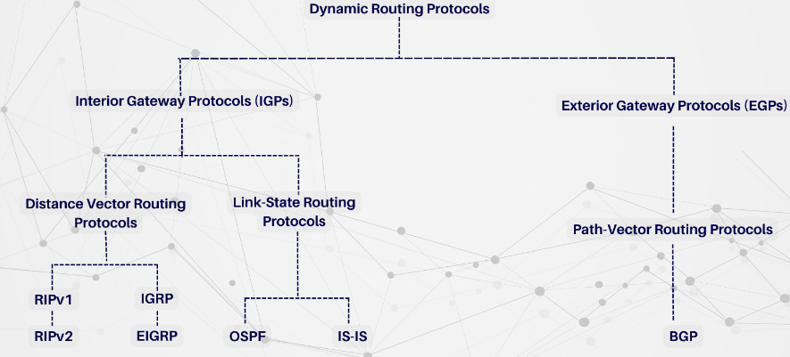

Slide 8
Distance Vector Routing Protocol (DVR)
Distance Vector Protocols advertise their routing table to every directly connected neighbor at specific time intervals using lots of bandwidths and slow converge.
Updates of the network are exchanged periodically, and it is always broadcast.
This protocol always trusts route on routing information received from neighbor routers.
As the routing information are exchanged periodically, unnecessary traffic is generated, which consumes available bandwidth.

Slide 9
Link State Routing Protocol
Link State Protocols take a unique approach to search the best routing path. In this protocol, the route is calculated based on the speed of the path to the destination and the cost of resources.
Routing protocol tables:
Link state routing protocol maintains below given three tables:
Neighbor table: This table contains information about the neighbors of the router only. For example, adjacency has been formed.
Topology table: This table stores information about the whole topology. For example, it contains both the best and backup routes to a particular advertised network.
Routing table: This type of table contains all the best routes to the advertised network.
This protocol maintains separate tables for both the best route and the backup routes, so it has more knowledge of the inter-network than any other distance vector routing protocol.
Concept of triggered updates are used, so it does not consume any unnecessary bandwidth.

Slide 10
Routing Information Protocol (RIP)
Request for Comments (RFC)
Routing Information System (RIP, Routing Information System) was first defined in RFC 1058 and is the first generation routing protocol of IPv4.
RIP is a distance vector routing protocol that uses metric hop counts.
RIP is easy to configure and is an excellent choice for small networks.
RIPv1 has the following characteristics:
Hop count is used as a path selection metric.
Routing updates (255.255.255.255) are sent every 30 seconds.
Anything over 15 hops is considered infinite (too far). This 15th-hop router does not send routing updates to subsequent routers.

Slide 11
In 1993, RIPv1 evolved into RIPv2, the classless routing protocol. RIPv2 adds:
Security: It includes an authentication mechanism to secure routing table update communication between neighbors.
Classless Routing Protocol Support: It supports VLSM and CIDR as routing updates include the subnet mask.
Improved efficiency: it forwards updates to the multicast address 224.0.0.9 instead of the broadcast address 255.255.255.255.
Reduce route entries: Support manual route summarization on any interface.
RIP updates are contained in UDP segments with both source and destination ports set to UDP port 520.

Slide 12
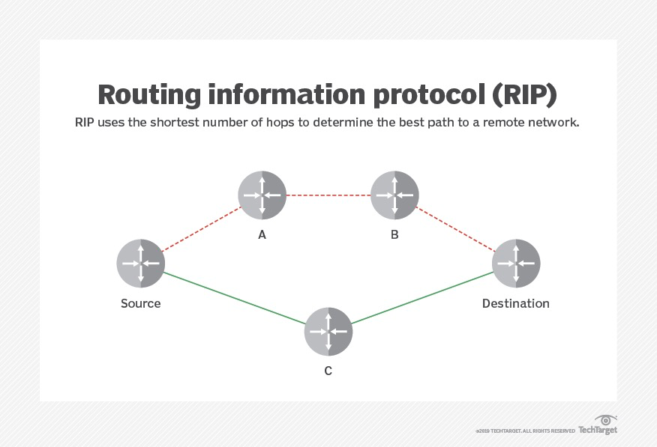

Slide 13
Open Shortest Path First (OSPF)
Open Shortest Path First (OSPF) is the most popular link-state routing protocol.
The earliest development began in 1987, and there are currently two active versions:
OSPFv2: for IPv4 networks (RFC 1247 and RFC 2328)
OSPFv3: For IPv6 networks (RFC 2740),
OSPFv3 now supports both IPv4 and IPv6 due to the address family feature.
OSPF is a link-state routing algorithm, mainly used in large and medium-sized networks.
OSPF is an intra-domain routing protocol that operates only within a specific routing domain.
OSPF is also a hierarchical routing protocol that can be used within a single autonomous system.
OSPF is developed on the IS-IS (intermediate-system-to-system) routing protocol of the OSI reference model.

Slide 14
OSPF supports multipath routing and uses one or more routing metrics, including reliability, bandwidth, delay, load, and maximum transmission unit (MTU), and it also allows type of service (TOS) requests to differentiate traffic.
OSPF uses the shortest path first (SPF) algorithm to ensure efficient data transmission, and data usually comes from link state advertisements transmitted by various routers.
When the topology changes, OSPF uses the Dijkstra algorithm to recalculate the path.
It also employs authentication procedures to maintain the security of its data throughout network modifications and intrusions.
Because of its scalability, OSPF is suitable for both small and large network enterprises.

Slide 15
Interior Gateway Routing Protocol (IGRP)
In 1984, Cisco created the Interior Gateway Routing Protocol (IGRP) to solve the problems of RIP in large networks.
IGRP is a distance vector protocol that uses a variety of routing metrics (not just hop counts) to calculate the distance to a destination.
IGP is majorly used by the routers to transit the data within the autonomous systems.
They are more suitable for large-sized networks as it contains a count of 255 and broadcast after every 90-sec interval.
It is fruitful for loop routing as it can automatically update the route whenever any kind of change takes place.

Slide 16
The IGRP protocol provides:
The ability to manage multiple "service types" with one set of data;
Prevent routing loops;
Maintain routing stability even in extremely large or complex networks;
Low overhead, IGRP consumes no more bandwidth than it needs to run;
Quick response to different network structures;
Split traffic along parallel routes when demand is equal;
Consider error rates and traffic levels on different paths.

Slide 17


Slide 18
IGRP is a distance vector protocol in which routers (often called gateways) exchange routing information only with neighboring routers.
IGRP is superior to RIP in terms of metrics.
It leverages many of the basic features of RIP and increases the maximum number of hops supported to 100.
It works better on large networks.
IGRP also helps prevent routing loops.

Slide 19
MANET Routing Protocols
A Mobile Ad hoc Network (MANET) is a decentralized wireless network composed of mobile devices.
it doesn’t rely on a pre-existing infrastructure, like routers or wireless access points, the network is ad hoc.
Every device in a MANET has the freedom to travel autonomously in any direction, which causes it to regularly swap ties with other devices.
Each must act as a router by forwarding traffic unrelated to its own use.
Equipping each device to keep the data necessary for appropriate traffic routing is the key problem in creating a MANET.

Slide 20
As the MANET grows in size, this becomes more difficult because of the following factors:
The need to route packets to/through every other node;
The amount of overhead traffic required to maintain real-time routing status
Each node has its own good put to route independently and unaware of others’ needs
All nodes must share limited communication bandwidth, such as a portion of radio spectrum.
These networks may function alone or in connection with the wider Internet.
They could have one, several, or different transceivers between the nodes.

Slide 21
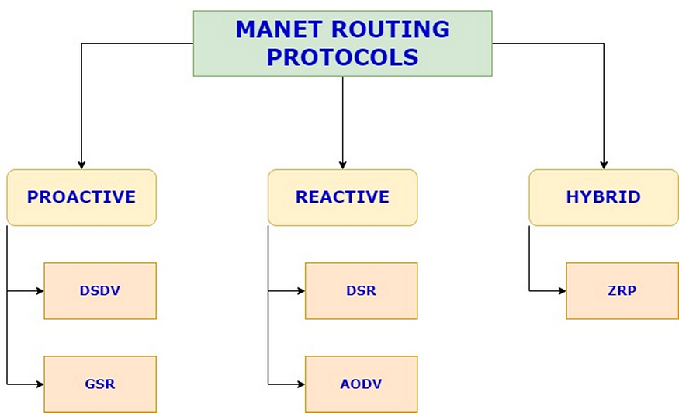
Routing Protocols:

Slide 22
Pro-active routing protocols:
In pro active or table driven protocols, every mobile node keeps a separate routing database that lists the paths to every potential destination mobile node.
These routing tables are updated periodically as and when the network topology changes because the mobile ad hoc network’s topology is dynamic.
Its weakness is that it struggles with huge networks since maintaining the route information to every potential node causes the routing table entries to grow too large.

Slide 23
Destination Sequenced Distance Vector Routing Protocol (DSDV):
It is a table-driven, proactive routing protocol.
Distance vector routing protocol was not suited for mobile ad-hoc networks due to count-to-infinity problem.
Hence, as a solution Destination Sequenced Distance Vector Routing Protocol (DSDV) came into picture.
Destination sequence number is added with every routing entry in the routing table maintained by each node.
A node will include the new update in the table only if the entry consists of the new updated route to the destination with higher sequence number.

Slide 24
Global State Routing (GSR):
It is a table-driven, proactive routing protocol.
The Dijkstra routing algorithm forms its foundation.
Link state routing protocol was not designed for mobile ad hoc networks since each node directly floods the network with link state routing information, or global flooding, which may create control packet congestion.
Global State Routing Protocol (GSR) was developed as a remedy.
Link state routing packets are not universally flooded into the network by global state routing.
Each mobile node in GSR keeps three tables, including an adjacency list, a topology table, a next hop table, and a distance table.

Slide 25
Dynamic Source Routing protocol (DSR):
It is a reactive/on-demand routing protocol.
In this type of routing, the route is discovered only when it is required/needed.
The process of route discovery occurs by flooding the route request packets throughout the mobile network. It consists of two phases:
Route Discovery:
Route Maintenance:

Slide 26
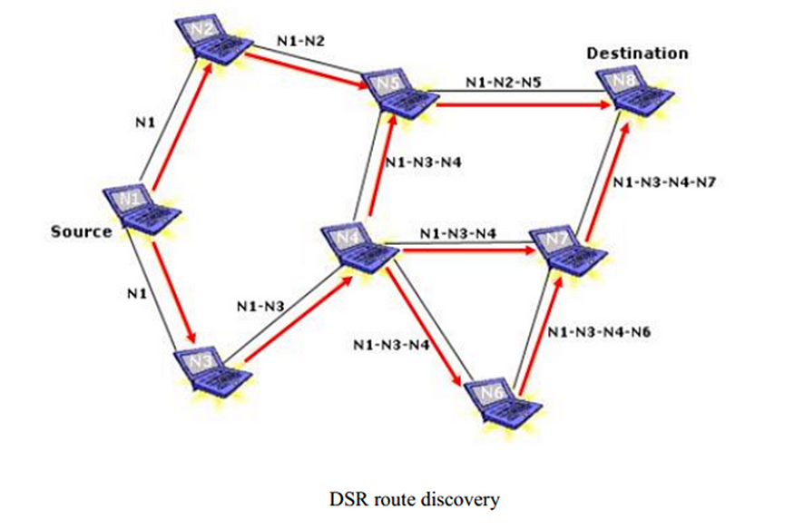
Route Discovery: This phase determines the most optimal path for the transmission of data packets between the source and the destination mobile nodes.
The source node will transmit a packet with a unique id, a list of nodes(which would be initially empty), the source and the destination, to the neighboring nodes.
When a particular node receives the packet, it will add itself to the list and retransmit to its neighboring nodes.
A node which has already received a packet will discard any other incoming nodes. When the packet reaches the destination, it will refer to the created list to identify the optimal path.

Slide 27
Route Maintenance: This phase performs the maintenance work of the route as the topology in the mobile ad-hoc network is dynamic in nature and hence, there are many cases of link breakage resulting in the network failure between the mobile nodes.

Slide 28
Ad-Hoc On Demand Vector Routing protocol (AODV):
It is a reactive/on-demand routing protocol. It is an extension of dynamic source routing protocol (DSR) and it helps to remove the disadvantage of dynamic source routing protocol.
In DSR, after route discovery, when the source mobile node sends the data packet to the destination mobile node, it also contains the complete path in its header.
Network size increases, the length of the complete path also increases and the data packet’s header size also increases which makes the whole network slow.
Ad-Hoc On Demand Vector Routing protocol came as solution to it.
The main difference lies in the way of storing the path, AODV stores the path in the routing table whereas DSR stores it in the data packet’s header itself.
It also operates in two phases in the similar fashion: Route discovery and Route maintenance.

Slide 29
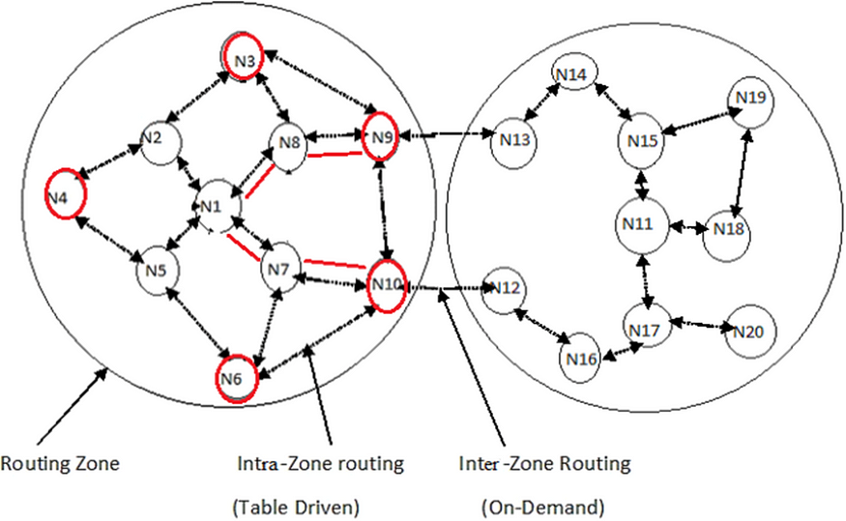
Hybrid Routing protocol:
The benefits of reactive and proactive routing protocols are essentially combined.
The source and destination mobile nodes’ zones and positions are taken into account when these protocols adjust. Zone Routing Protocol (ZRP) is one of the most widely used hybrid routing protocols.
After segmenting the network into several zones, the locations of the source and destination mobile nodes are tracked.
Proactive routing is used to transmit the data packets between the source and destination mobile nodes if they are both located in the same zone.
Additionally, reactive routing is used to transmit the data packets between the source and destination mobile nodes if they are situated in different zones.

Slide 30
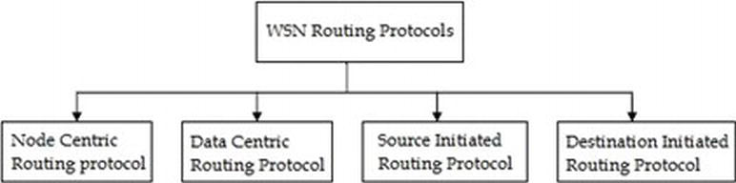
Classification of routing protocols (WSN)
The routing protocols define how nodes will communicate with each other and how the information will be disseminated through the network.
There are many ways to classify the routing protocols of WSN.

Slide 31
Node centric
In node centric protocols the destination node is specified with some numeric identifiers and this is not expected type of communication in Wireless sensor networks.
E.g. Low energy adaptive clustering hierarchy (LEACH).

Slide 32
Low energy adaptive clustering hierarchy (LEACH)
LEACH is a routing protocol that organizes the cluster such that the energy is equally divided in all the sensor nodes in the network.
In LEACH protocol several clusters are produced of sensor nodes and one node defined as cluster head and act as routing node for all the other nodes in the cluster.
The cluster head is selected before the whole communication starts and the communication fails [If there is any problem occurs in the cluster head and there is much chances that the battery dies earlier as compare to the other nodes in cluster as the fix cluster head is working its duties of routing for the whole cluster].
LEACH protocol apply randomization and cluster head is selected from the group of nodes so this selection of cluster head from several nodes on temporary basis make this protocol more long lasting as battery of a single node is not burdened for long.
Sensor nodes elect themselves as cluster head with some probability criteria defined by the protocol and announce this to other nodes

Slide 33
Data-centric
In most of the wireless sensor networks, the sensed data or information is far more valuable than the actual node itself.
Therefore data centric routing techniques the prime focus is on the transmission of information specified by certain attributes rather than collecting data from certain nodes.
In data centric routing the sink node queries to specific regions to collect data of some specific characteristics so naming scheme based on attributes is necessary to describe the characteristics of data.

Slide 34
Sensor Protocols for information via negotiation (SPIN)
SPIN is abbreviation of sensor protocol for information via negotiation.
This protocol is defined to use to remove the deficiency like flooding and gossiping that occurs in other protocols.
The main idea is that the sharing of data, which is sensed by the node, might take more resources as compare to the meta-data, which is just a descriptor about the data sensed, by the node.
The resource manager in each node monitors its resources and adapts their functionality accordingly.

Slide 35
Sensor Protocols for Information via Negotiation (SPIN) is a family of adaptive protocols designed for efficient data dissemination in wireless sensor networks (WSNs).
SPIN protocols are particularly focused on energy conservation, data-centric communication, and overcoming challenges such as limited power, bandwidth, and computational resources in sensor networks.
Key Features of SPIN:
Data Negotiation:SPIN protocols use a negotiation process to eliminate redundant data transmission and prevent unnecessary energy expenditure.
Data Naming:Data in SPIN is assigned high-level names, which are used during the negotiation phase.
Resource Awareness:SPIN protocols are designed to be aware of the resource constraints in WSNs.

Slide 36
Types of SPIN Protocols:
SPIN-PP (Point-to-Point):This is the basic version of SPIN where nodes use point-to-point communication to negotiate data transmission with their neighbors.
SPIN-EC (Energy-Constrained):An extension of SPIN-PP, this protocol includes energy considerations. Nodes with low energy may choose not to participate in data transmission to conserve their power.
SPIN-BC (Broadcast):SPIN-BC uses broadcast communication for data dissemination, allowing a node to send data to all its neighbors simultaneously, thus potentially reaching more nodes with fewer transmissions.
SPIN-RL (Reliable):This version of SPIN includes mechanisms to ensure reliable data delivery, which is important in networks where data loss is critical.

Slide 37
Working Mechanism:
ADV Message (Advertisement):A node that has new data to share broadcasts an ADV message containing a description of the data.
REQ Message (Request):Neighboring nodes that are interested in the data (i.e., they do not have it) respond with a REQ message to request the data.
DATA Message:The original node then sends the requested data to those nodes that sent a REQ message.

Slide 38
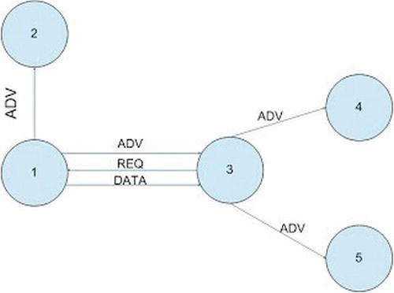
Three messages namely ADV, REQ and DATA are used in SPIN.
The node broadcast an ADV packet to all the other nodes that it has some data.
This advertising node ADV message includes attributes of the data it has.
The nodes having interests in data, which the advertising node has requested by sending REQ message, to the advertising node.
On receiving the REQ message the advertising node send data to that node.
This process continues when the node on reception of data generate an ADV message and send it.

Slide 39
Destination-initiated (Dst-initiated)
Protocols are called destination initiated protocols when the path setup generation originates from the destination node. Examples are directed diffusion (DD) & LEACH.
Directed diffusion (DD)
Directed diffusion is a data centric routing technique. It uses this data centric technique for information gathering and circulating.
This routing protocol is also energy efficient and energy saving protocol so that’s why life time of the network is increased.
All the communication in directed diffusion routing protocol is node to node so there is no need of addressing in this protocol.

Slide 40
Source-initiated (Src-initiated)
Source-initiated (Src-initiated) protocols are a type of communication strategy used in networking, particularly in wireless sensor networks (WSNs) and ad hoc networks.
In these protocols, the communication process is initiated by the source node, which has data to send to one or more destination nodes.
These protocols are typically designed to address specific challenges such as energy efficiency, dynamic network topology, and low latency in data transmission.
Key Characteristics of Source-Initiated Protocols:
Initiation by Source Node: The source node, which has data to send, begins the communication process.
Route Discovery: In ad hoc networks, the source node often needs to discover the route to the destination.
On-Demand Communication: Source-initiated protocols typically follow an on-demand approach, meaning that routes or communication paths are established only when the source node has data to send.
Energy Efficiency:By initiating communication only when necessary, these protocols can save energy, which is crucial in WSNs where nodes often have limited battery power.
Dynamic Adaptation:These protocols can adapt to changes in network topology, such as nodes moving or going offline, by discovering new routes or paths as needed.

Slide 41
Medium Access Link Adaptation
Medium Access Control (MAC) is a critical component in wireless communication networks, responsible for managing how devices access the shared communication medium (such as radio frequency spectrum) and ensuring that data transmission occurs efficiently and without excessive interference.
Link adaptation is a dynamic mechanism integrated into the MAC layer to optimize communication performance under varying channel conditions.
Link adaptation is a critical mechanism in wireless communication systems that dynamically adjusts the transmission parameters based on the current conditions of the communication link.
The primary goal of link adaptation is to maximize the data throughput and ensure reliable communication under varying channel conditions.

Slide 42
Why is Link Adaptation Needed in Medium Access?
In wireless communication, the quality of the link between a transmitter and receiver can vary due to several factors, such as distance, interference, signal fading, and environmental changes.
Medium Access Control (MAC) protocols must efficiently manage these dynamic conditions to optimize network performance. Link adaptation is needed to:
Enhance Reliability: Adjust transmission parameters like modulation schemes and coding rates to maintain communication quality even in poor channel conditions.
Optimize Throughput: Dynamically select the best transmission rate based on the current link quality to maximize data throughput.
Improve Efficiency: Conserve energy and reduce the need for retransmissions by adapting to the link conditions, which is particularly important in energy-constrained networks like sensor networks.

Slide 43
Overview of Medium Access Control (MAC)
The MAC layer in wireless networks is responsible for coordinating the access to the shared wireless medium. It ensures that multiple devices can transmit data without causing collisions or excessive interference. Common MAC protocols include:
Time Division Multiple Access (TDMA): Devices take turns to transmit in pre-assigned time slots.
Frequency Division Multiple Access (FDMA): Devices transmit over different frequency channels.
Code Division Multiple Access (CDMA): Devices use unique code sequences to transmit simultaneously over the same frequency.
Carrier Sense Multiple Access with Collision Avoidance (CSMA/CA): Devices listen to the medium before transmitting to avoid collisions, commonly used in Wi-Fi networks.
In wireless environments, the quality of the communication link can change rapidly due to factors like signal fading, interference, and user mobility. To address these challenges, the MAC layer incorporates link adaptation mechanisms.

Slide 44
Link Adaptation Mechanisms
Link adaptation refers to the dynamic adjustment of transmission parameters, such as modulation scheme, coding rate, transmission power, and data rate, based on the current link quality. The goal is to maintain reliable communication and optimize data throughput.
Modulation Scheme: Determines how data is encoded onto the carrier signal. Higher-order modulation schemes (e.g., 64-QAM) allow for higher data rates but require better signal quality. Lower-order schemes (e.g., BPSK) are more robust but offer lower data rates.
Coding Rate: Refers to the amount of error-correcting information added to the transmitted data. A lower coding rate means more redundancy, which improves error correction but reduces the effective data rate.
Transmission Power: Adjusting the power can help maintain a strong signal, but excessive power can cause interference with other devices.
Data Rate: The transmission speed can be adjusted according to the channel conditions. Higher data rates are used when the link is good, while lower rates are used in poor conditions to maintain reliability.

Slide 45
Feedback Mechanisms:
Signal-to-Noise Ratio (SNR): The ratio of the signal power to the noise power in the channel. Higher SNR indicates better link quality, allowing for higher data rates and more complex modulation schemes.
Packet Error Rate (PER): The ratio of the number of incorrectly received packets to the total number of received packets. A high PER suggests that the link quality is poor, prompting the system to lower the data rate or switch to a more robust modulation scheme.
Channel State Information (CSI): Provides detailed information about the current state of the channel, including multipath effects and fading characteristics. CSI is used for more precise link adaptation decisions.

Slide 46
MAC Layer and Link Adaptation Interactions
The MAC layer utilizes link adaptation to manage how devices access the medium based on real-time link conditions. This interaction is crucial for ensuring efficient and reliable communication in dynamic wireless environments.
Adaptive Modulation and Coding (AMC): AMC is a key component of link adaptation, where the MAC layer adjusts the modulation and coding scheme based on the feedback from the physical layer. For example, in a Wi-Fi network:
Good Channel Conditions: The MAC layer selects a higher MCS index, which uses a more complex modulation (e.g., 64-QAM) and a higher coding rate to maximize throughput.
Poor Channel Conditions: The MAC layer lowers the MCS index, switching to a simpler modulation (e.g., BPSK) and a lower coding rate to maintain reliable communication.

Slide 47
Rate Adaptation in CSMA/CA (Wi-Fi): In Wi-Fi networks, the MAC layer uses rate adaptation to adjust the transmission rate based on the feedback from previous transmissions. The MAC layer observes parameters like the number of ACKs received, the retransmission count, and the SNR to decide whether to increase or decrease the transmission rate.
Power Control: Power control is another aspect of link adaptation, where the MAC layer adjusts the transmission power based on the link quality. In environments with high interference, reducing the transmission power can help minimize the impact on other devices while still maintaining a reliable link.

Slide 48
Applications of Link Adaptation in Modern Wireless Networks
Wi-Fi Networks: Link adaptation is crucial in Wi-Fi networks, where it helps manage varying link qualities due to factors like distance, interference from other devices, and obstacles. Modern Wi-Fi standards like IEEE 802.11ac and 802.11ax use sophisticated link adaptation techniques to optimize performance across multiple users and devices.
Cellular Networks: In cellular networks, link adaptation is used to optimize the communication between mobile devices and base stations. Techniques like AMC and power control are essential for managing the highly dynamic conditions in cellular environments.
Wireless Sensor Networks (WSNs): In WSNs, link adaptation is vital for energy efficiency. Adaptive power control and modulation can significantly extend the lifetime of battery-powered sensor nodes while maintaining reliable communication.

Slide 49
Link Adaptation in Wi-Fi
Link adaptation in Wi-Fi networks is a crucial mechanism that allows the wireless system to dynamically adjust its transmission parameters to maintain optimal performance in response to changing environmental conditions and user mobility.
This process is essential to ensure that Wi-Fi connections are stable, reliable, and efficient, even in environments with fluctuating signal quality.

Slide 50
Rate Adaptation
Rate adaptation is one of the most prominent forms of link adaptation in Wi-Fi. The process involves dynamically selecting the most appropriate data transmission rate (measured in Mbps) based on the current signal quality between the access point (AP) and the client device.
Higher Data Rates: When the signal quality is good (high Signal-to-Noise Ratio, or SNR), the Wi-Fi device can use higher data rates with more complex modulation schemes, like 64-QAM or 256-QAM. These allow for more bits to be transmitted per symbol, increasing throughput.
Lower Data Rates: In poor signal conditions (low SNR, due to distance, obstacles, or interference), the device will drop to lower data rates with simpler modulation schemes, like BPSK or QPSK. This reduces the chances of errors and maintains a reliable connection.

Slide 51
Modulation and Coding Scheme (MCS)
Wi-Fi standards, particularly those from IEEE 802.11n and onwards (including 802.11ac and 802.11ax), use a Modulation and Coding Scheme (MCS) index to define the combination of modulation, coding rate, and spatial streams used for transmission.
Modulation: Wi-Fi can use various modulation techniques, such as BPSK, QPSK, 16-QAM, 64-QAM, and 256-QAM. The choice of modulation affects the data rate and the robustness of the transmission.
Coding Rate: The coding rate determines how much redundancy is added to the data. Higher coding rates add less redundancy but are less error-tolerant, while lower coding rates add more redundancy, making the transmission more robust against errors.
MCS Index: The MCS index is used to quickly adjust the transmission parameters. For instance, in good conditions, a high MCS index with 256-QAM and a high coding rate may be used. In poor conditions, a lower MCS index with BPSK and a lower coding rate may be chosen.

Slide 52
Channel Bandwidth
Wi-Fi devices can operate over different channel bandwidths, such as 20 MHz, 40 MHz, 80 MHz, and even 160 MHz in 802.11ac and 802.11ax standards.
Wide Channels: Wider channels (e.g., 80 MHz or 160 MHz) can carry more data, allowing for higher throughput. However, they are more susceptible to interference and noise, especially in crowded environments.
Narrow Channels: In scenarios with high interference or poor signal quality, Wi-Fi devices might use narrower channels (e.g., 20 MHz) to maintain a more reliable connection, even though this results in lower throughput.

Slide 53
Transmit Power Control
Link adaptation as modulation or coding, transmit power control is another essential aspect of Wi-Fi operation. Adjusting the transmit power can help optimize the link:
High Power: Higher transmission power increases the signal's reach, potentially improving the link quality over longer distances or in environments with obstacles.
Low Power: Lower power reduces interference with other devices and can conserve battery life in mobile devices. It also reduces the noise floor, which can be beneficial in dense environments.

Slide 54
Feedback Mechanisms
Wi-Fi link adaptation relies on feedback mechanisms to assess link quality and make necessary adjustments. This feedback can include:
ACK/NACK Packets: Packets indicate whether the transmitted data is received correctly. A high rate of NACK (Negative Acknowledgment) packets or missed ACKs might prompt the system to reduce the data rate or switch to a more robust modulation and coding scheme.
Channel State Information (CSI): Some Wi-Fi standards allow the receiver to send detailed CSI back to the transmitter, providing information about the link's condition. This allows for more sophisticated and precise adjustments.
Packet Error Rate (PER): Monitoring the error rate of received packets can help decide whether to switch to a different MCS or adjust other parameters.

